Slide 1
Welcome to Dartmouth Radiology!
Things we think you’ll care about

Slide 2
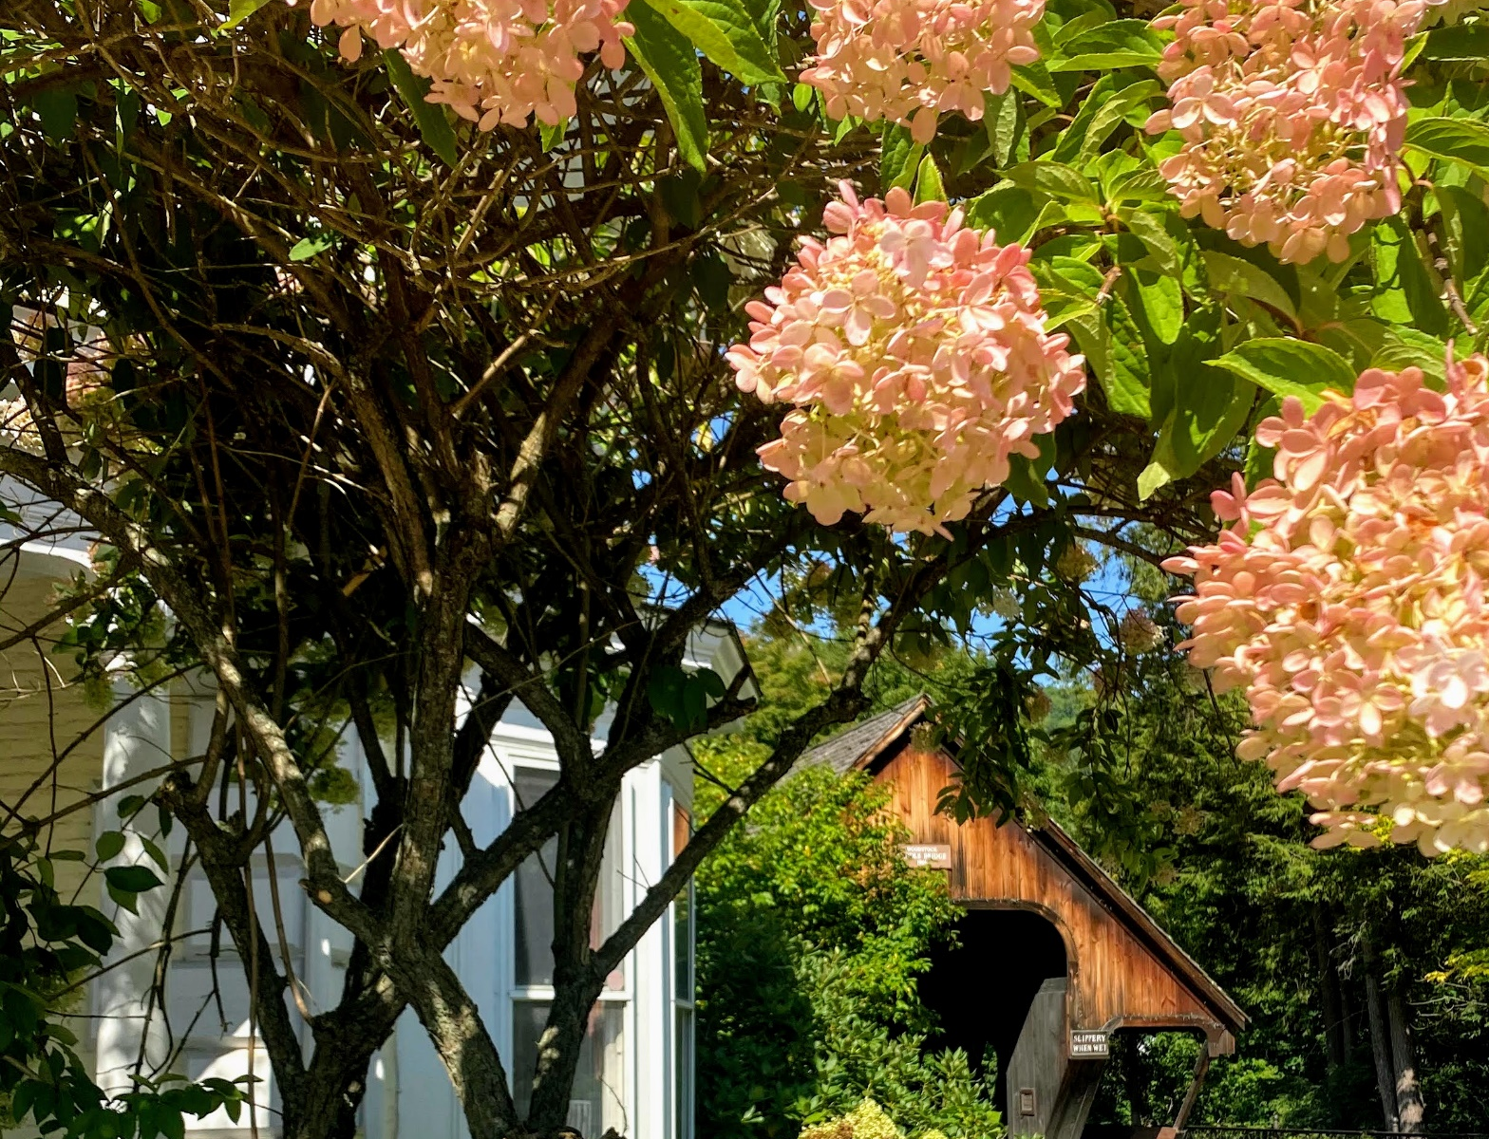
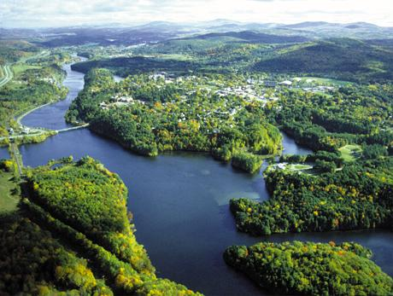

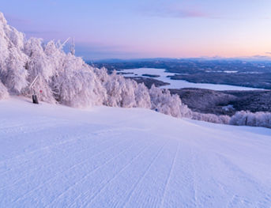
We wish you could visit!
We are lucky enough to the live in one of the most beautiful parts of the country.
Every season in the Upper Valley (including parts of both Vermont and New Hampshire) has something to offer!
Notes:
Spring in Woodstock, VT
Summer overlooking Hanover and the Connecticut Rive. Picture taken from the Vermont side of the rive

Slide 3
FAQs - Logistics
Salary: PGY-2: 66,300 - PGY-3: 69,035 - PGY-4: 72,929 - PGY-5: 76,086
  Reviewed yearly for inflation by GME and institutional resident committee
Vacation: 15 days + 5 personal days
  Comp day for one week of IR call (DR R1-R4; IR R1-R3)
  6 observed D-H holidays
    0.5 comp day for non-IR holiday call
    1 comp day for IR holiday call
Parking: FREE
Affordable, resident-catered health insurance plan with $0 deductible for you and enrolled spouse/dependents for all services/specialists.
  EVERYTHING (within DH system) is covered!

Slide 4
FAQs – Day to Day
Average day
  Average M-F hours are 8:00am to 5:00 pm for most rotations, daily didactics from 12:15-1:00
  Resident protected time from 11:45-12:15 to use at your own discretion - championed by our very own PD
Our volumes
  400 bed academic hospital and an additional 9 community hospitals we cover
  New D-H patient tower opening in Spring 2023 (120 beds total)
Procedures
  Most of our services perform their own procedures and you are encouraged to begin performing them on day 1 with attending direction.
Few fellows
  2-3 fellows per year (1-2 body, 1 neuro), meaning our residents get to read advanced imaging and perform procedures early.
CORE and Certifying Exam pass rates: 100% since inception of both exams

Slide 5
FAQs – Money!
Book Fund
  $500 per year ($$): $300 GME, $200 Departmental contribution
ABR Dues
  Application fee ($640) and Core exam fee ($1280)
Study Resources
  Radprimer and StatDx ($)
Conferences
  Travel, lodging and food for any meeting/conference presentation of which you are first author ($$$)
CORE Review Courses
  Duke Review, NERRS Core Review, and Telerad Physics (formerly known as Huda) Review ($$$)
AIRP
  Dues fully paid. Travel, lodging and food if choose to go in person ($$-$$$$)

Slide 6
FAQs – Our call structure
R1
  Buddy (preparatory) Call with senior resident in second half of year
  3 weeks of IR home call (carry pager for IR consults/procedures from 5:30pm-7am for 7 days)
R2-R3
  Four weeks of Night Float (Two 2-week blocks)
  ~20 late stay shifts (12p-9p; off morning), 4 weekend day shifts (8a-7p), and 4 Saturday overnight shifts (7p-8a)
  1-2 weeks of IR home call
R4
  Four weeks of Night Float (Two 2-week blocks)
  ~20 late stays, 4 weekend day shifts, and 4 Saturday overnight shifts (7p-8a)
Attending in house 24/7, however residents prelim studies and our department is busy enough that referring services routinely act on your reads
Notes:
Remember call shifts can change. Our current PGY-5s applied and interviewed back in 2017. Used to be Friday 5p-8a and Sat 5p-8a. PD has listened to

Slide 7
DR Block Schedule

Slide 8
IR Block Schedule

Slide 9
IR Procedure Numbers

Slide 10
FAQs – Recent fellowship matches
Barrows Neurological Institute
Boston Children’s Hospital
Brigham and Women’s Hospital
Dartmouth-Hitchcock Medical Center
Duke University Medical Center
Emory
Johns Hopkins
Mallinckrodt Institute of Radiology
Massachusetts General Hospital
Mayo Clinic
Memorial Sloan Kettering Hospital
NY Presbyterian-Weill Cornell Medical Center
University of California Los Angeles
University of California San Diego
University of California San Francisco
University of Minnesota
University of Virginia
University of Washington
University of Wisconsin
Yale
Notes:
Graduating class of 2023: MSK at Duke, MSK at Mallinckrodt, Neuroradiology at Dartmouth
Class of 2022: Neuroradiology at MGH x2, Body Imaging at Dartmouth x2
Class of 2021: Abdominal Imaging/Cross Sectional IR at UCLA, Straight to private practice, Breast imaging at UCSF
Class of 2020: Cardiothoracics at MGH, Body at Dartmouth x2
Class of 2019: Pediatrics at BCH, Cardiothoracics at Mayo, MSK at MIR, Neuroradiology at DHMC
Class of 2018: Body/Breast at Dartmouth, Breast at UVA, Breast at Sloan Kettering, Neuroradiology at Dartmouth, Neuroradiology at Barrow

Slide 11
Thank You!
Department of Radiology
Dartmouth-Hitchcock Medical Center

